Slide 1
Underwater 3D Reconstruction Experiment
孙凤娜
2016.11.21

Slide 2
CONTENTS
Experinmental theory
Ⅰ
Ⅱ
Experimental scheme
Ⅲ
Experiment
Experimental analysis
Ⅳ
Ⅴ
Future work

Slide 3



I. Experinmental theory
Calibration board

Slide 4
I. Experinmental theory
Calibration

Slide 5
I. Experinmental theory
(a) Pixel calibration matrix
(b) World calibration matrix

Slide 6
I. Experinmental theory
laser line scanning

Slide 7

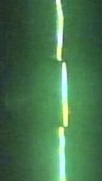
I. Experinmental theory
Laser line center extraction

Slide 8
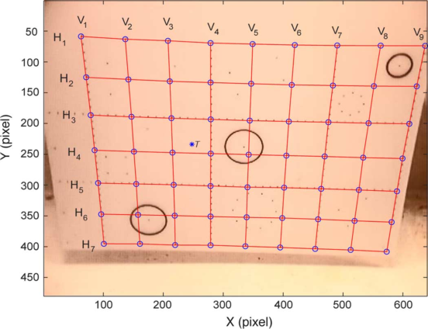
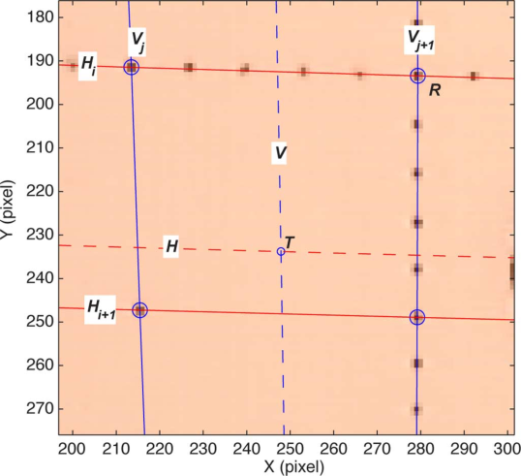
I. Experinmental theory
coordinate conversion

Slide 9
I. Experinmental theory

Slide 10
Ⅱ.Experinmental scheme
Experimental Device
Line laser
Camera
Calibration board
Guide Rail
Object

Slide 11
Ⅱ.Experinmental scheme
System setting

Slide 12
●The flow chart of experiment
Ⅱ.Experinmental scheme
System setting
coordinate conversion
3D reconstruction
Image acquisition
line center extraction
Camera calibration
Laser line scanning
Notes:
1) 对所有扫描图像进行激光线条的中心计算，得到新图像序列；
2) 读取（1）处理后的一张图像；
3) 按顺序，搜索图像上含有信息（值非 0）的、未被处理的某点，读取此点的像素坐标；
4) 在像素标定矩阵中，寻址距离此点最近的 4 个相邻标定点（如前文所述，假设数据点为 P，则这四个相邻标定点需要满足 以下条件：某一标定点距离 P 点最近，四个标定点包裹 P 点，或者与 P 点重合）；
5) 按照坐标转换公式计算此点所对应的世界坐标；
6) 重复（3）-（5）步骤，遍历图像上所有有信息的点，进行坐标计算；
7) 重复（2）-（6）步骤，处理整个图像序列；
8) 将前面 7 步所得数据沿扫描方向累加，重建出三维图像。

Slide 13
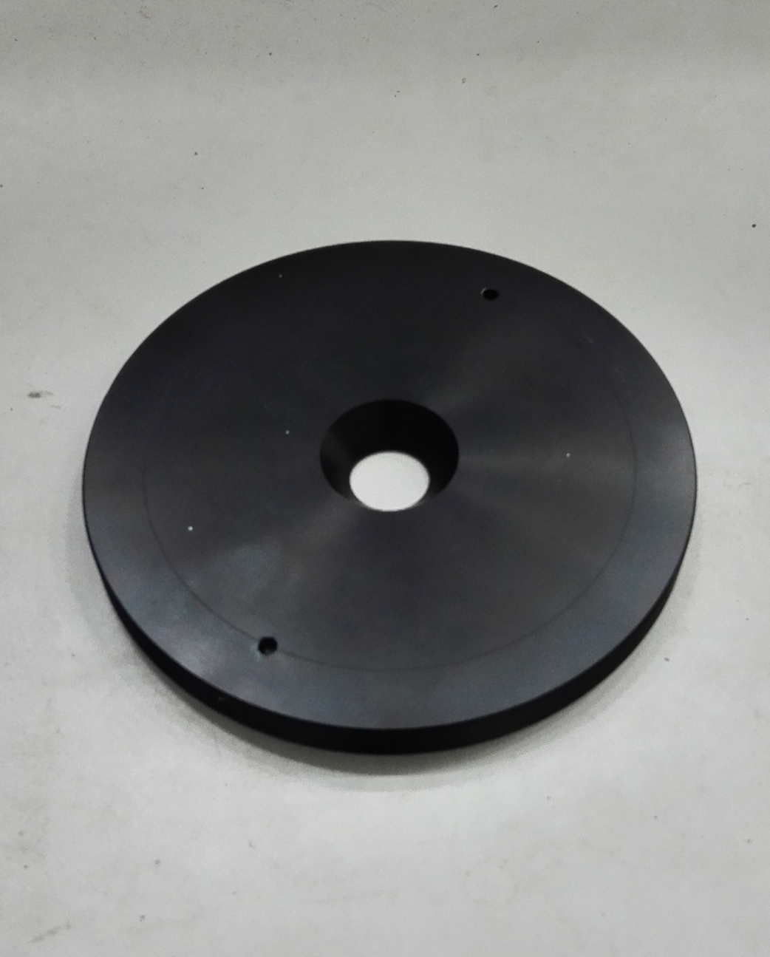
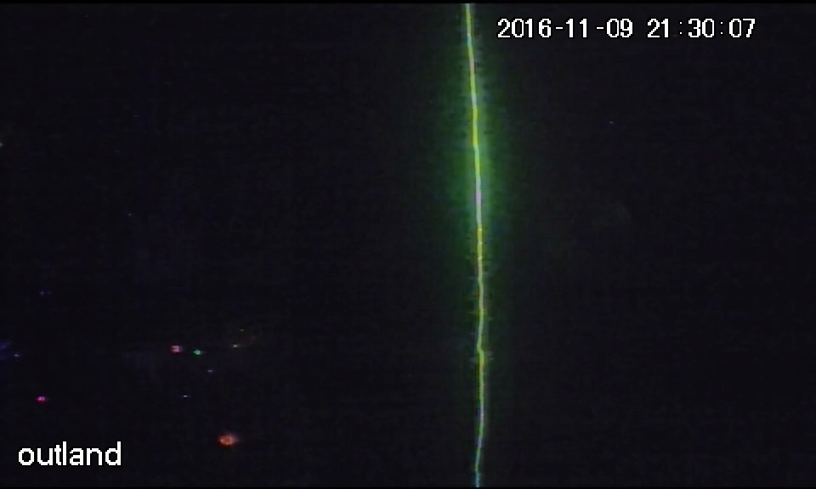
Ⅲ. Experiment
Video

Slide 14
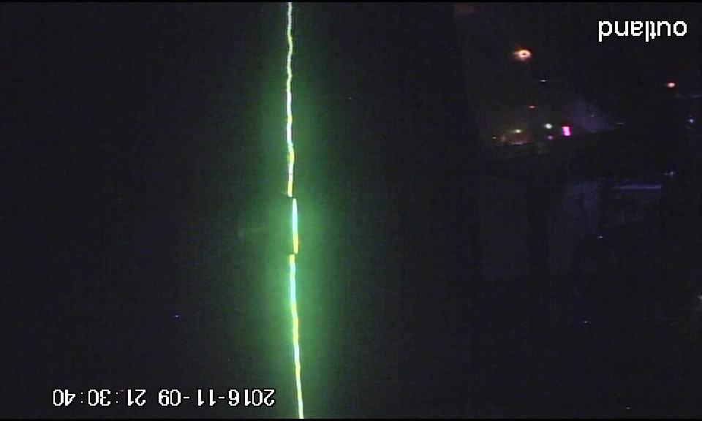
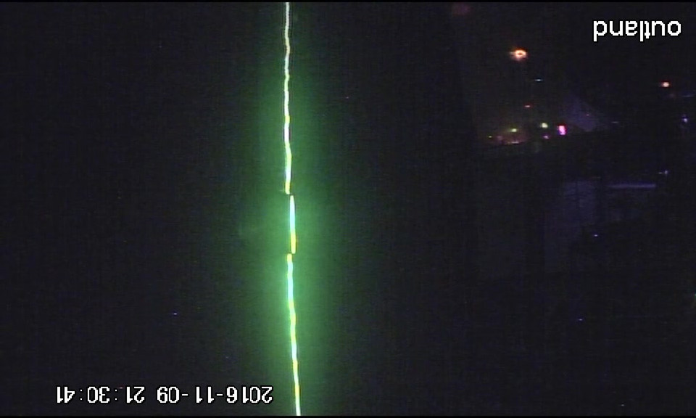
Ⅲ. Experiment
Image Sequence(Total_video_converter)

Slide 15
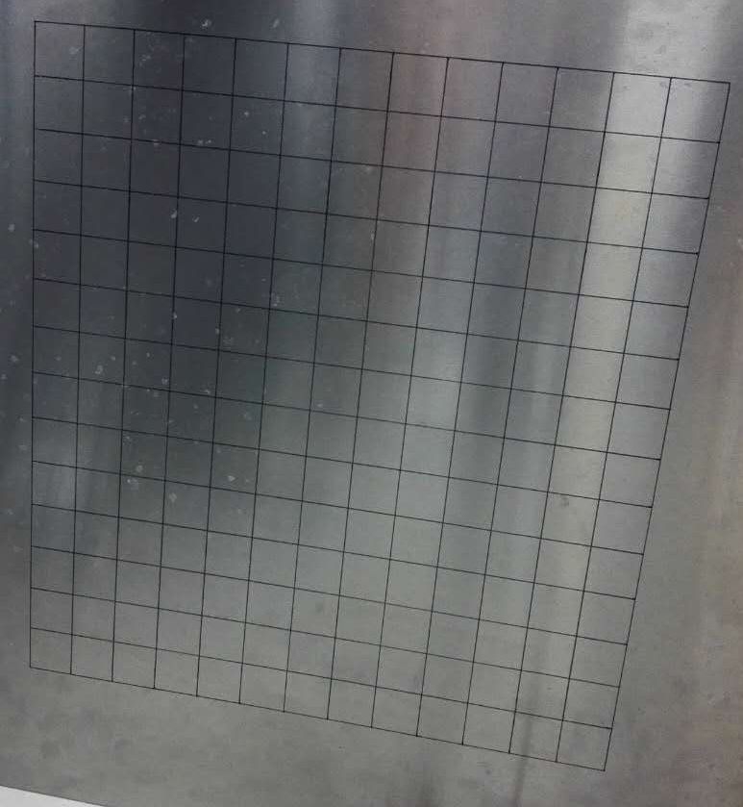
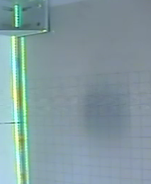
Ⅲ. Experiment
Calibration

Slide 16
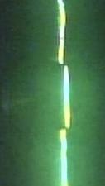
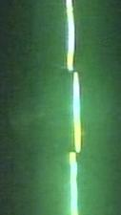
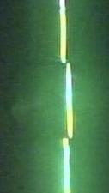
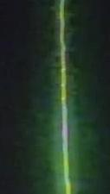





Ⅲ. Experiment
Laser line center

Slide 17
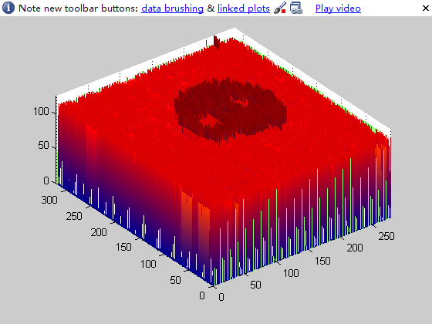
Ⅲ. Experiment
Coordinate conversion

Slide 18
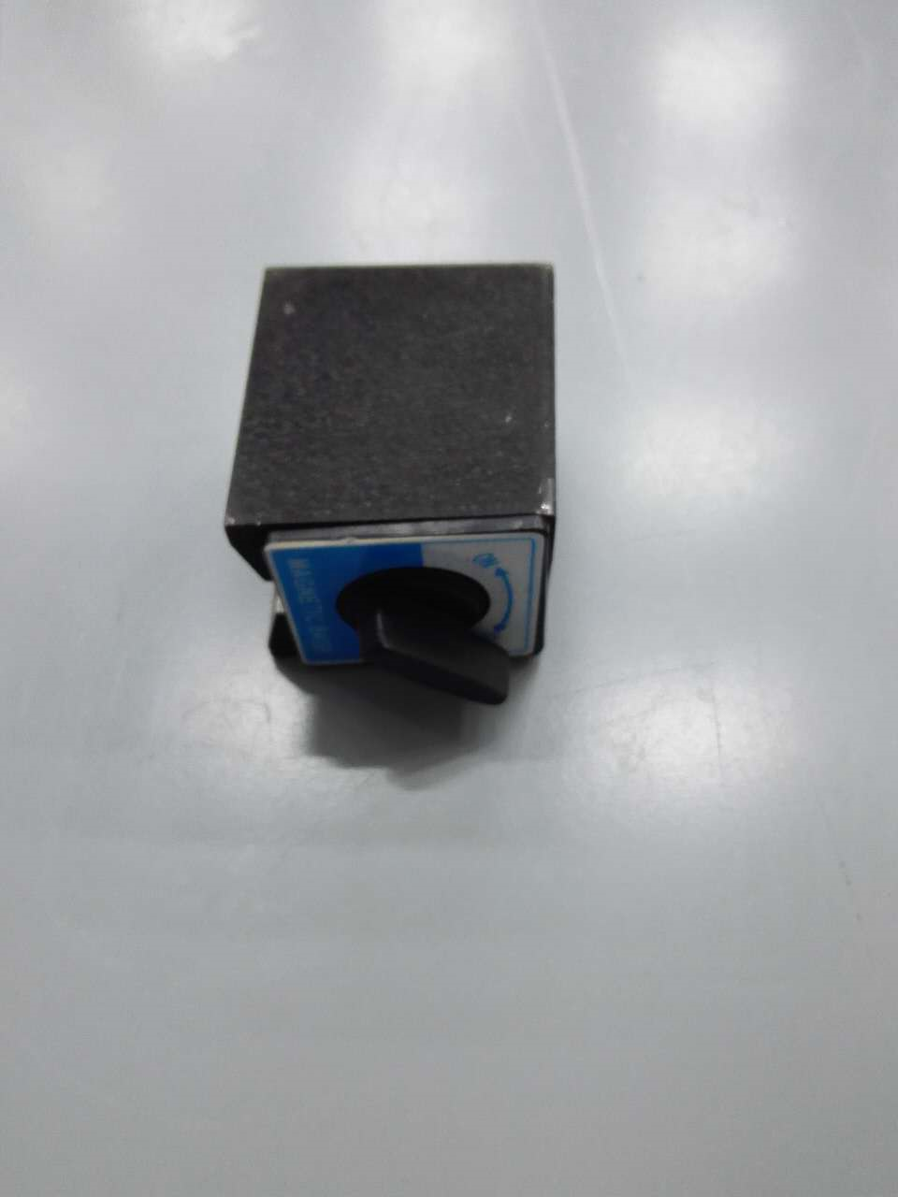
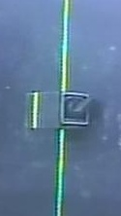
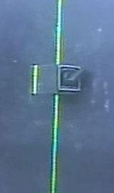
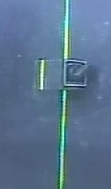



♦Illumination
Ⅲ. Experiment
Notes:
会有别的光影响

Slide 19
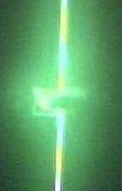
Ⅳ. Experimental analysis
♦Camera setting
♦Selection of object
♦Background
♦Clipping region
♦Calibration
♦Coordinate conversion

Slide 20

As for calibration
Ⅳ. Experimental analysis

Slide 21
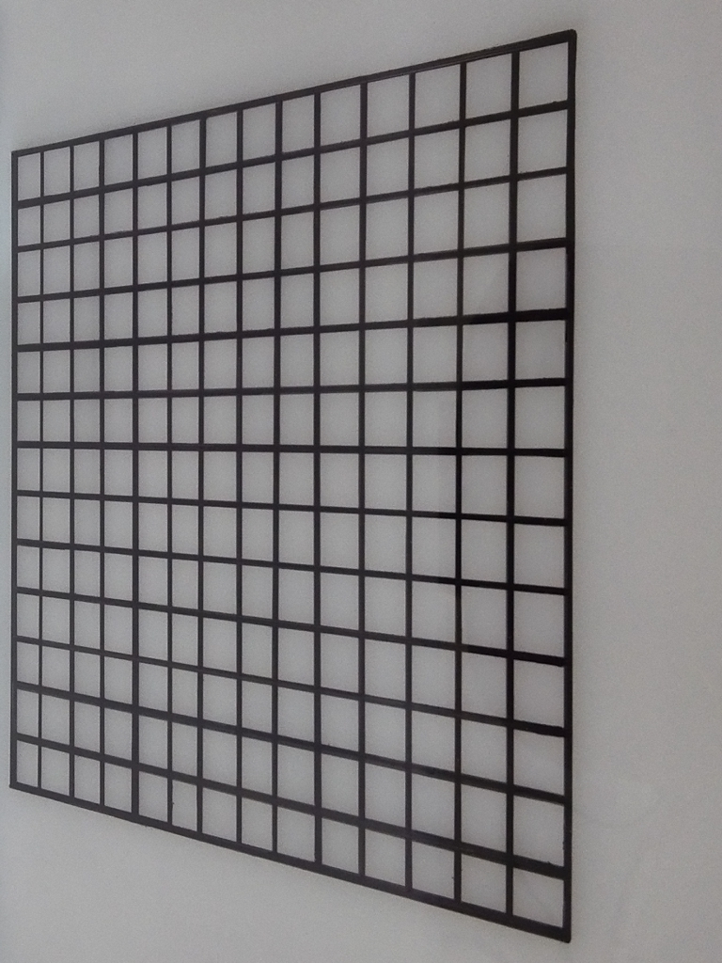
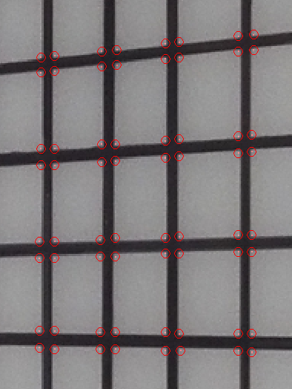
As for calibration
Ⅳ. Experimental analysis

Slide 22
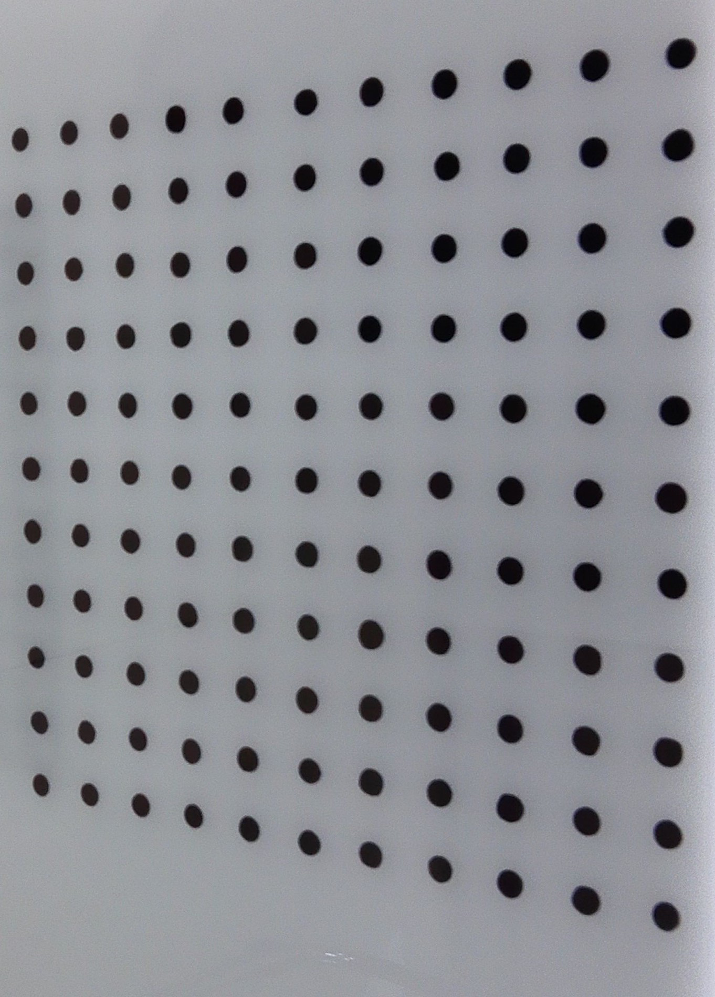
Ⅳ. Experimental analysis

Slide 23
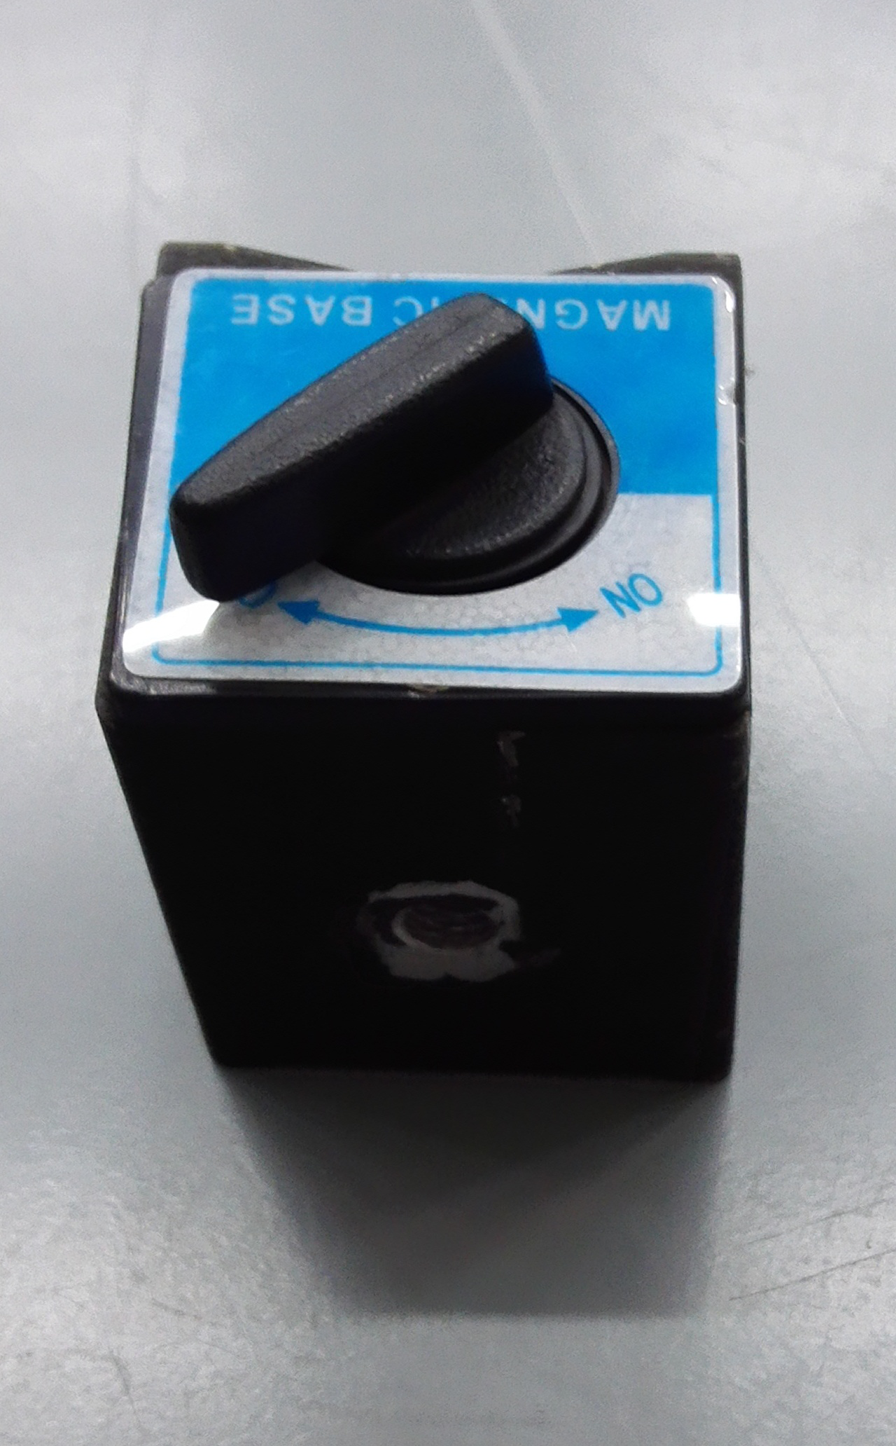
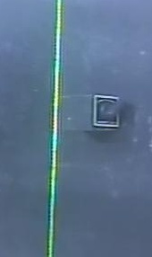
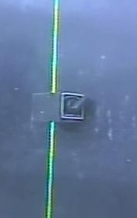
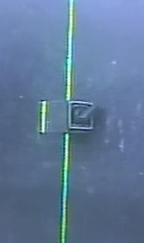
Ⅳ. Experimental analysis
Unsolved
♦The order of the images after cutting；
♦Blind area

Slide 24
Ⅴ. Future work
Improve the method of data processing
Do some underwater experiments
Try my best to solve the problem of blind area

Slide 25
THANKS

